Slide 1
RISC-V Cores in IoT Applications
10/16/2022
ThaiNgo

Slide 2
01
02
03
PROCESSOR CORES
SOC PLATFORMS
PULP PLATFORM

Slide 3
PULP PLATFORM
01

Slide 4

PULP PLATFORM
PULP is a silicon-proven Parallel Ultra Low Power platform targeting high energy efficiencies.

Slide 5
PROCESSOR CORES
02

Slide 6
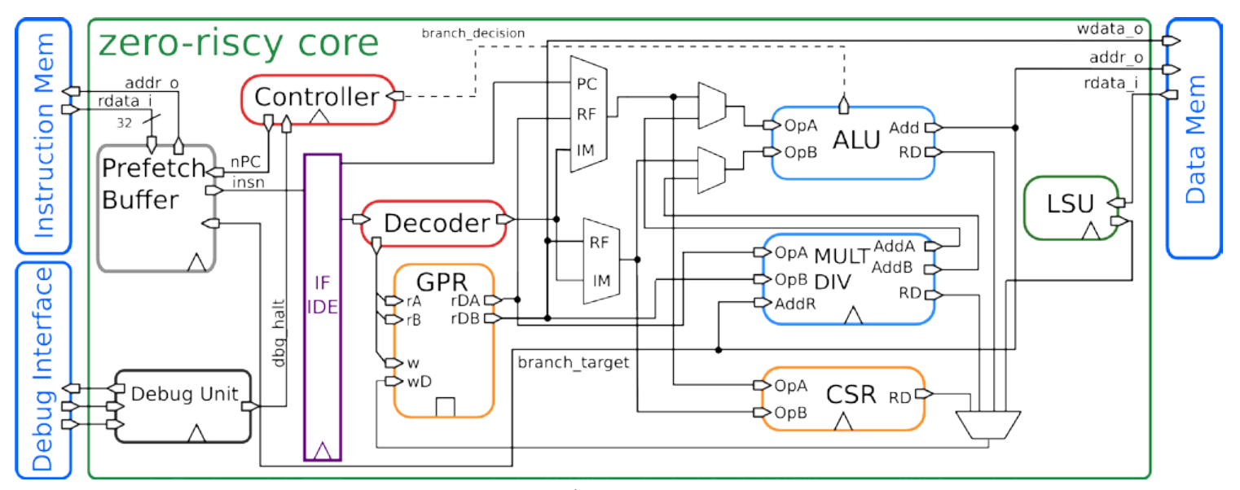
IBEX (ZERO-RISCY)
Block Diagram

Slide 7
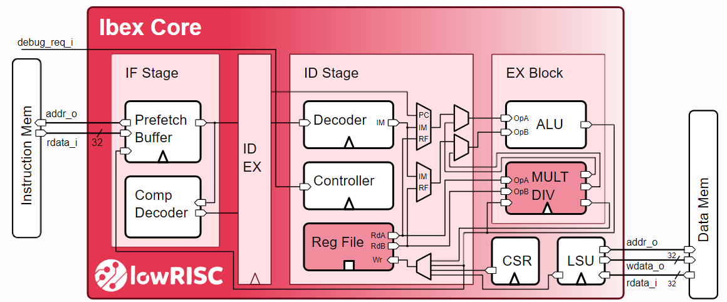
IBEX (ZERO-RISCY)
ZERO-RISCY pipeline

Slide 8
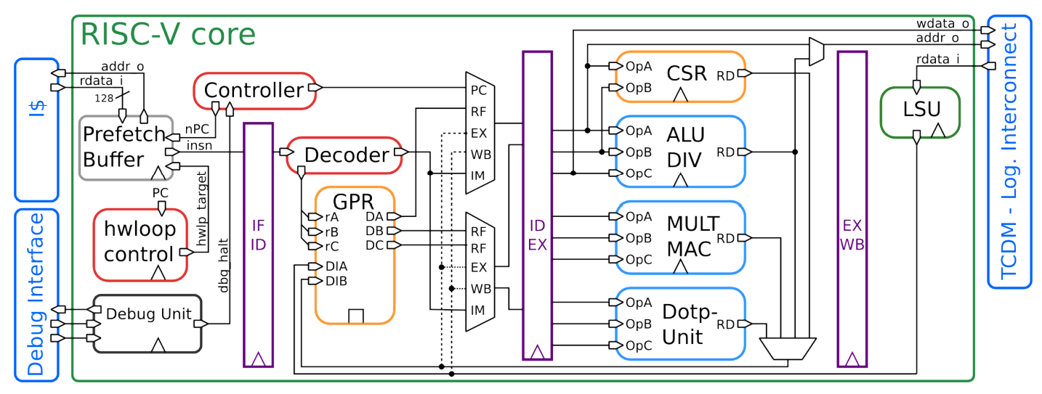
CV32E40P (RI5CY)

Slide 9
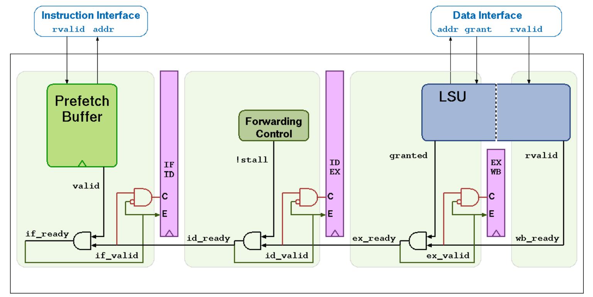
CV32E40P (RI5CY)
Block Diagram

Slide 10
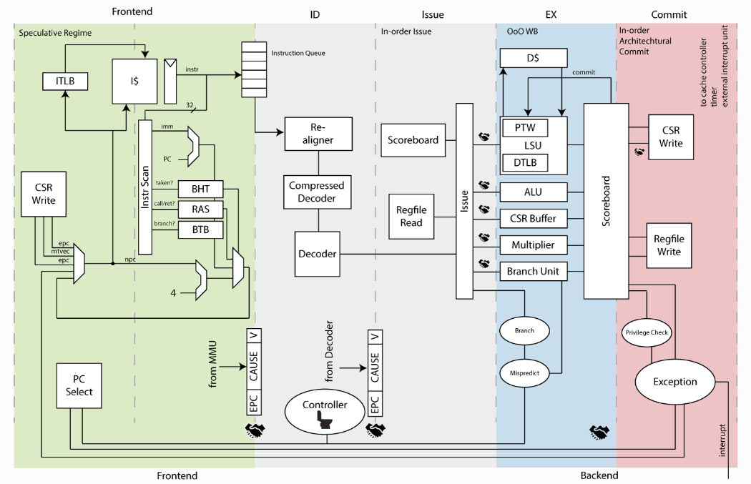
CVA6 (Ariane)
ZERO-RISCY pipeline

Slide 11
COMPARISONS
IBEX
CV32E40P
CVA6
Support RV32I, RV32E, RV32C, RV32M
2-stage pipeline:
- Instruction Fetch (IF)
- Instruction Decode and Execute (ID/EX)
Support RV32I, RV32C, RV32M, RV32F, Xcorev, Xpulpcluster, Xpulpzfinx
4-stage pipeline
- Instruction Fetch (IF)
- Instruction Decode (ID)
- Execute (EX)
- Writeback (WB)
Support RV64I, RV64IC, RV64M, RV64 privilege extension
6-stage pipeline
- PC Generation
- Instruction Fetch
- Instruction Decode
- Issue
- Execute
- Commit

Slide 12
SOC PLATFROMS
03

Slide 13
SOC PLATFROMS
Single-core micro-controllers
Multi-core IoT Processors
Multi-cluster heterogeneous accelerators

Slide 14
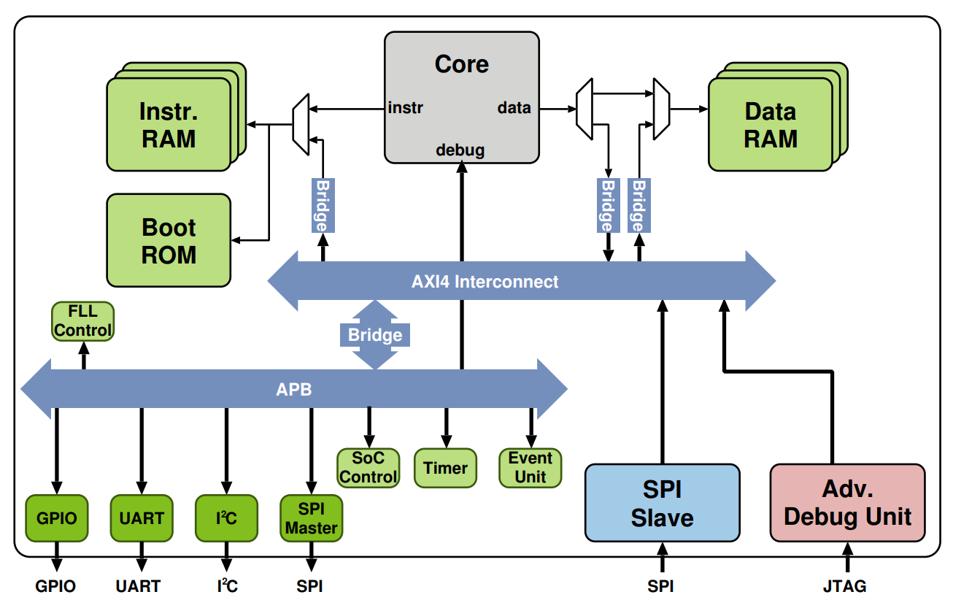
SINGLE-CORE MICRO-CONTROLLERS
PULPino

Slide 15
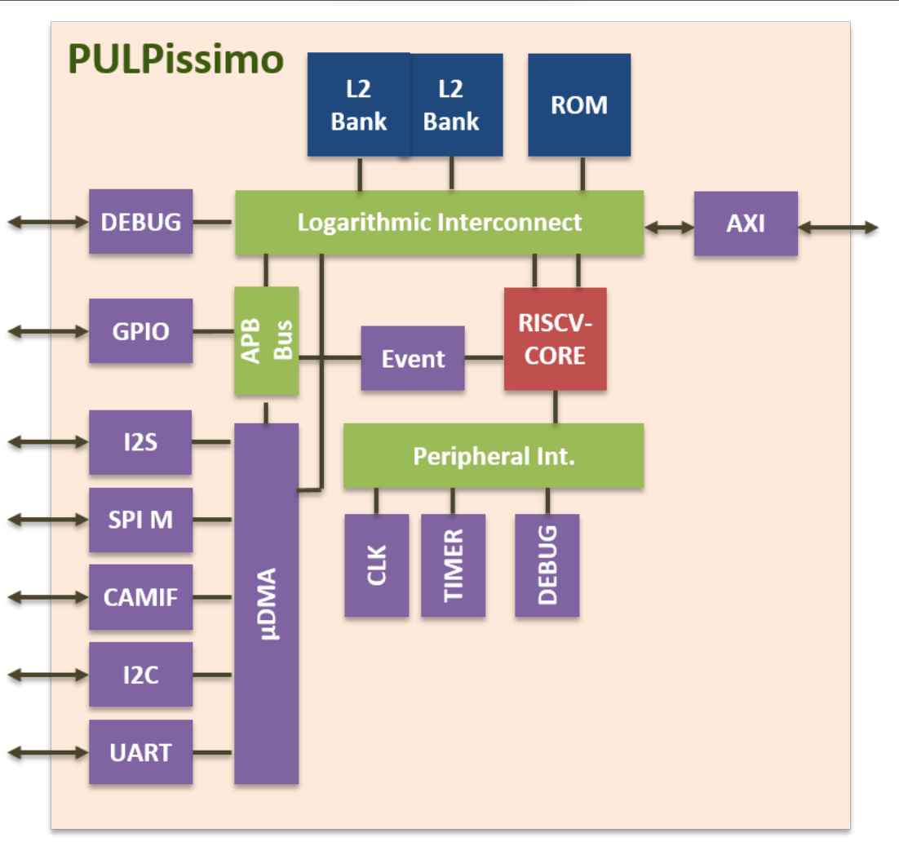
SINGLE-CORE MICRO-CONTROLLERS
PULPissimo

Slide 16
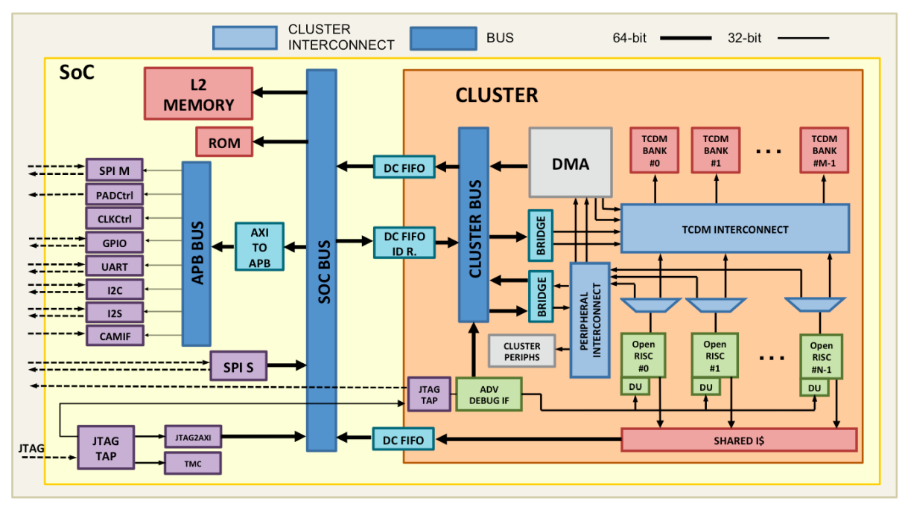
MULTI-CORE IOT PROCESSORS
OpenPULP

Slide 17
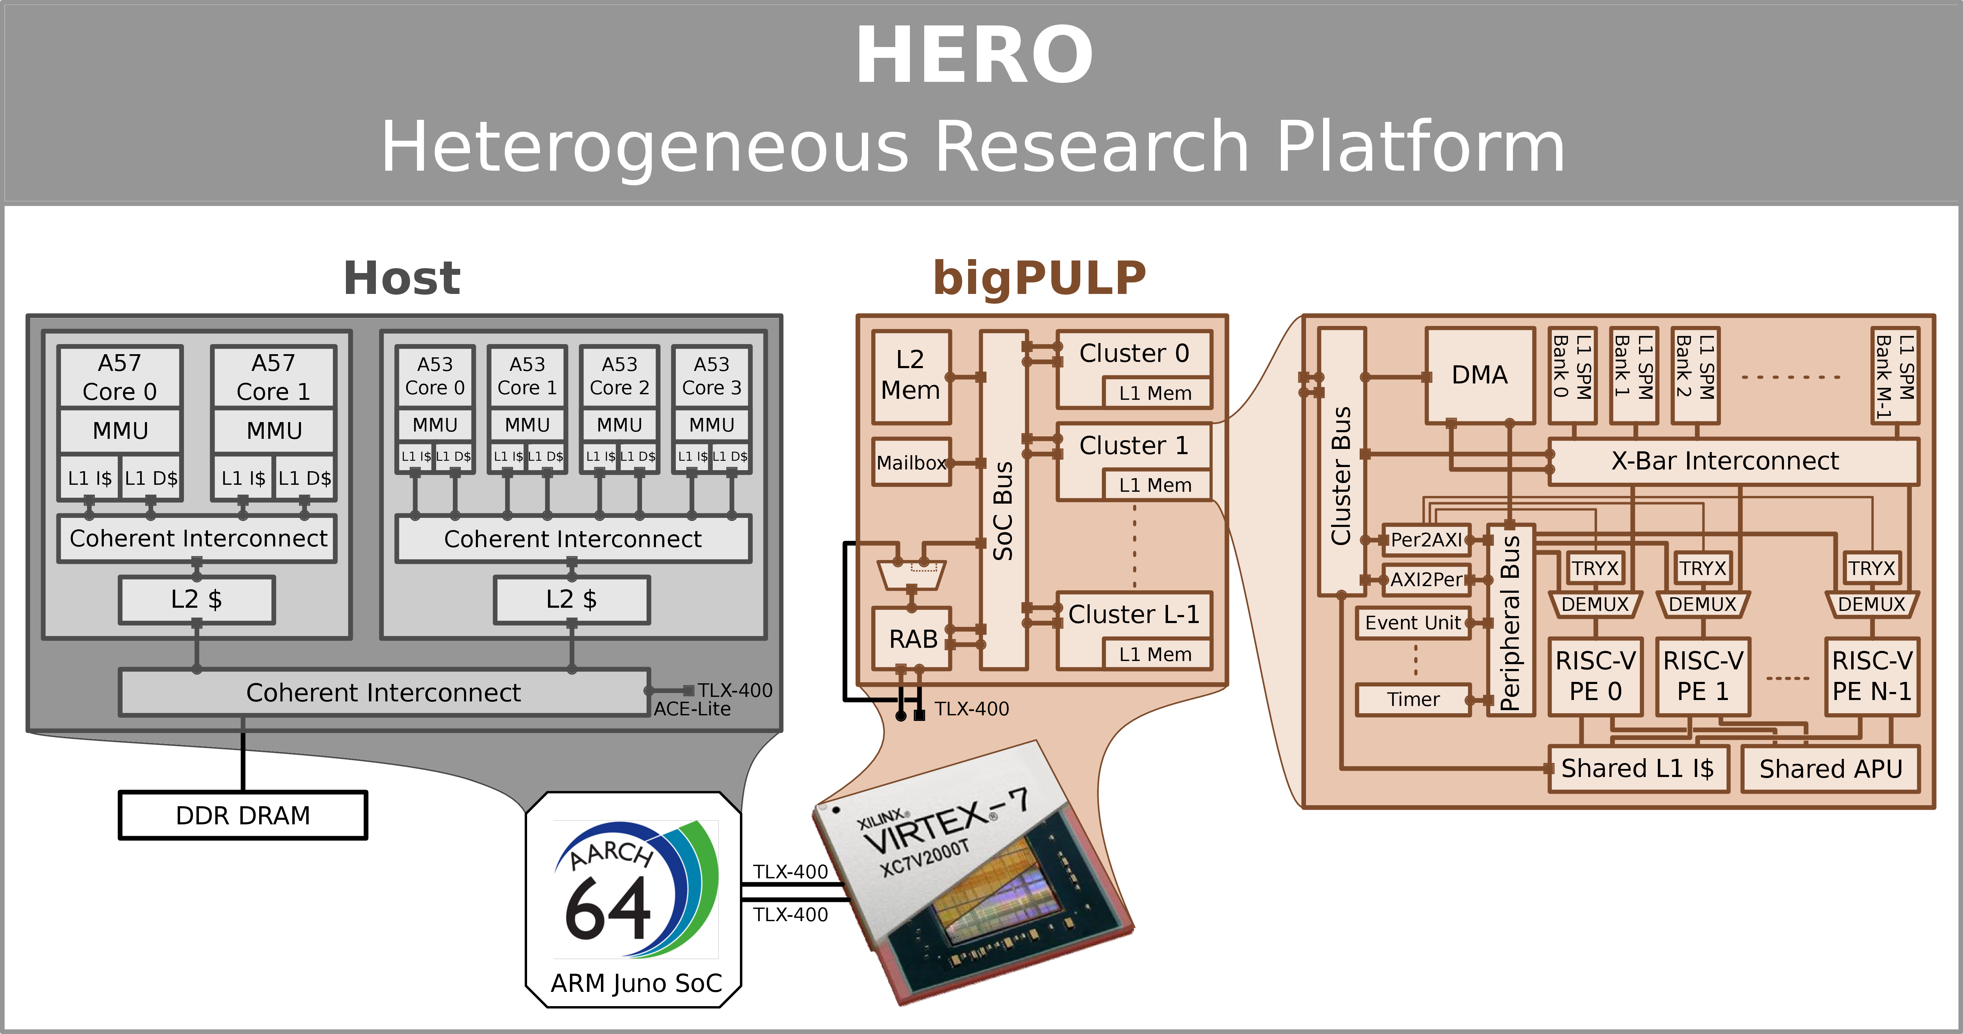
MULTI-CLUSTER HETEROGENEOUS ACCELERATORS
HERO

Slide 18
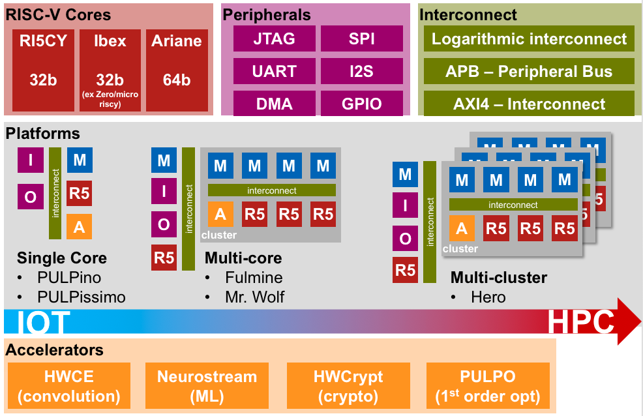
SUMMARY

Slide 19
THANKS!
Do you have any questions?
Please keep this slide for attribution.

